Slide 1

Enhancing Wazuh SIEM with Cross-Layer Security and AI-based Anomaly Detection
Group Members
Supervisor
Hamad Ali — F22605010
Muhammad Awais — F22605035
Amir Ali — F22605044
Muhammad Zohaib Arif — F22605046
Maj. Babar Yousaf
Lec. Saima Yasmeen
Muhammad Faheem
Co-Supervisor
Industry Supervisor

Slide 2

Project Scope
AI-based anomaly detection for logs and telemetry
Cross-layer security monitoring: Network, Host, Cloud
Real-time threat detection, correlation, and alerting
Risk scoring engine and alert visualization
Tasks Completed
Integration and monitoring milestones achieved:
Wazuh SIEM Deployment
Kibana Dashboard Visulization
AI Anomaly Detection
Isolation/Random Forest Detection
Log Correlation
Risk Scoring & Alerts

Slide 3
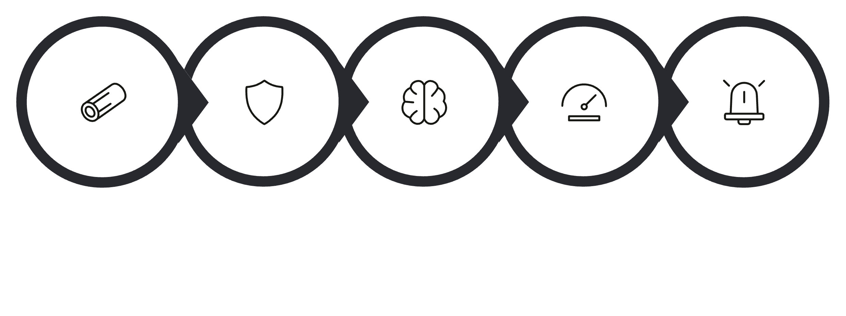
System Workflow
Logs Collection
Wazuh SIEM
AI Models
Risk Scoring
Dashboard Alerts
Logs Collection
Wazuh Processing
AI Models
Netflow, firewall, host agents, cloud audit logs
Normalization, enrichment, correlation rules
Random Forest and Isolation Forest for classification for anomaly scoring
Risk Scoring
Dashboard Alerts
Contextual score mapped to LOW / MEDIUM / HIGH
Prioritized alerts with drill-down and suggested response

Slide 4
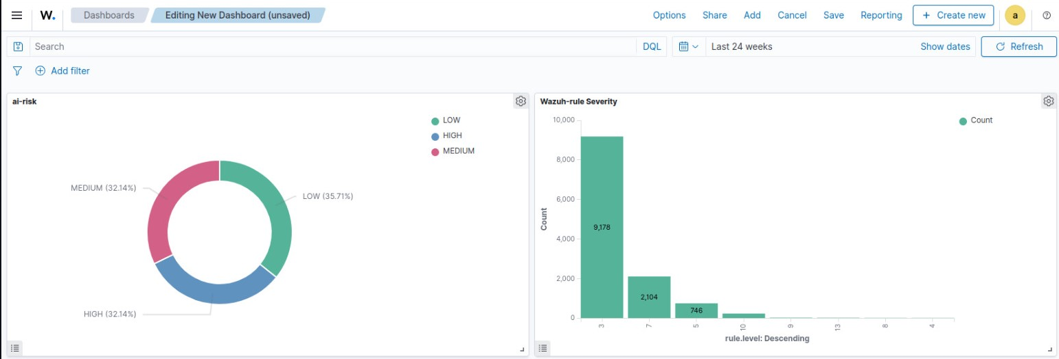
Dashboard Preview
Future Enhancements
Current Status
Prototype Completed — core pipeline validated
Simulated lab Environment using multiple VM’s
Cloud-native deployment and autoscaling
Automated containment & response
Enrich feeds with threat intelligence
SOC automation & runbooks

Slide 5



SDGs
Improves organizational cybersecurity resilience and protects digital business operations from cyber threats.
Enhances cybersecurity infrastructure using AI-powered SIEM and intelligent monitoring systems.
Supports secure digital environments, cyber defense, and real-time threat monitoring.

